Slide 1
Internet Censorship and Online Speech Chapter 7: Content Moderation at Scale
Nick Feamster University of Chicago
Notes:
`

Slide 2
Internet Censorship and Online Speech Chapter 7.1: Content Moderation at Scale (Imperfect Solutions)
Nick Feamster University of Chicago

Slide 3
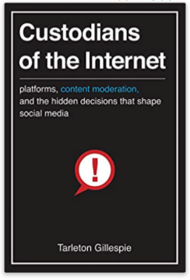
Content Moderation is Not New
Many parties have been “in the middle” in the past
Broadcasters
Booksellers
Publishers
What’s new?
Number of users
Amount of content
Pace of circulation

Slide 4
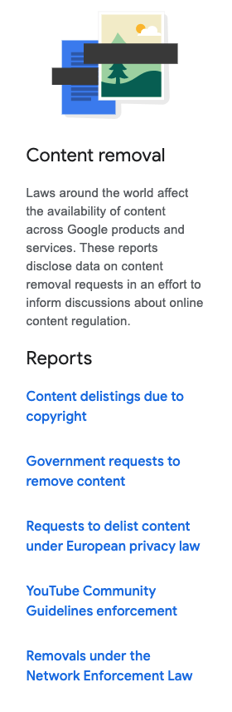
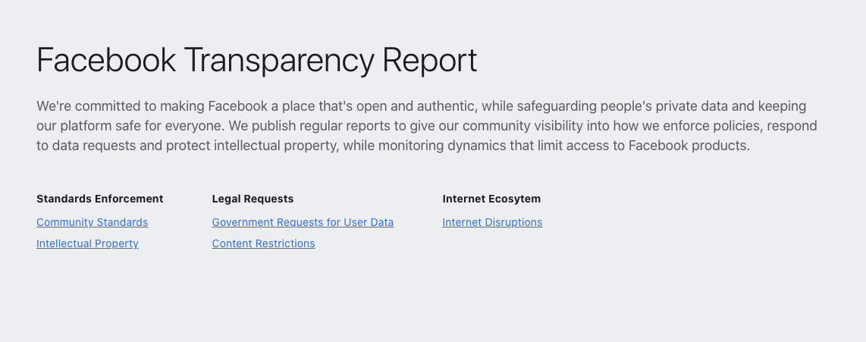
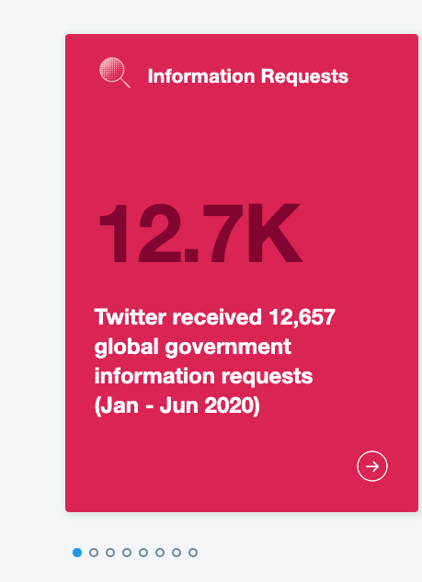
Transparency Reports
Major platforms publish requests for takedown and subsequent actions
General approach:
“Publish then filter”
Just about anything can be published until a request for takedown is issued

Slide 5
Three Approaches to Content Moderation (Gillespie)
Editorial review
Community flagging
Automatic detection

Slide 6
Editorial Review
Possible for traditional media
Judgements about content relevance can be made at the same time as judgements about harm or offense
Language can be adjusted before publication
Live television (seven-second delay)
Extension to social media, app stores
Apple’s App Store “gatekeeper model” (who sets the rules?)
Caveats: Administrative burden, scope creep, etc.
Biggest Challenge: Scale

Slide 7
Community Flagging
“Flagging” mechanism to alert user to objectionable content
Divide and conquer for the work/task of identifying content
Appears more democratic (may not be in practice, however)
Still requires enormous resources from the platform
Facebook receives millions of reports to review each day
Variety of languages and reporting mechanisms used
Little room for context

Slide 8
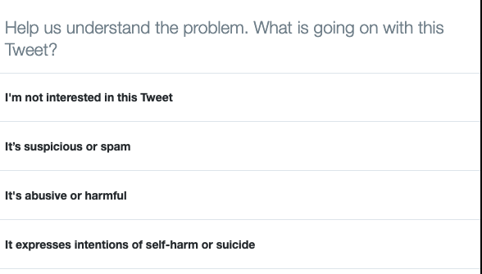
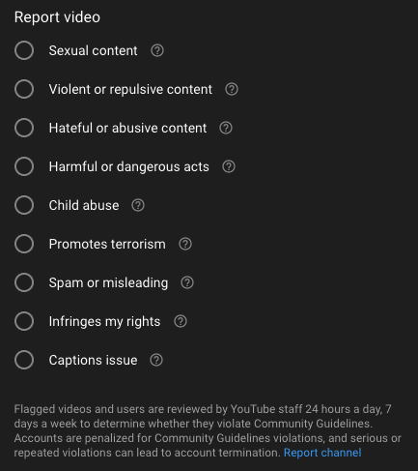
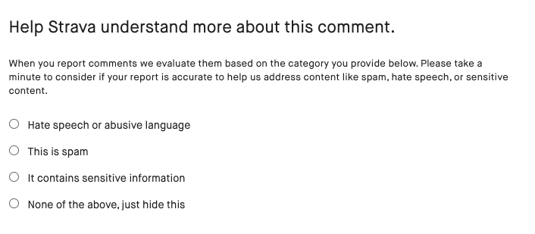

Slide 9
Automated Detection (“AI”)
Potential to address the problem at scale.
But…
Automated techniques are designed, tested, overridden by people.
Most of these systems are not sophisticated (e.g., keywords)
Some may be biased, or lack transparency.
AI is good at recognizing certain things (e.g., skin tone) but bad at context.

Slide 10
Summary
There are various ways to moderate content, all imperfect
Editorial review has issues of gatekeeping and scale
Community flagging still faces issues of scale and leaves little room for context
“AI” is imperfect, and designed by humans nonetheless (and still ultimately requires a human in the loop)
Are some platforms simply “too big”?

Slide 11
Internet Censorship and Online Speech Chapter 7.2: Personalization (and Filter Bubbles)
Nick Feamster University of Chicago

Slide 12
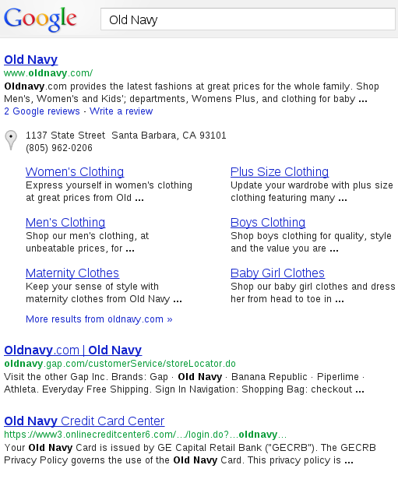
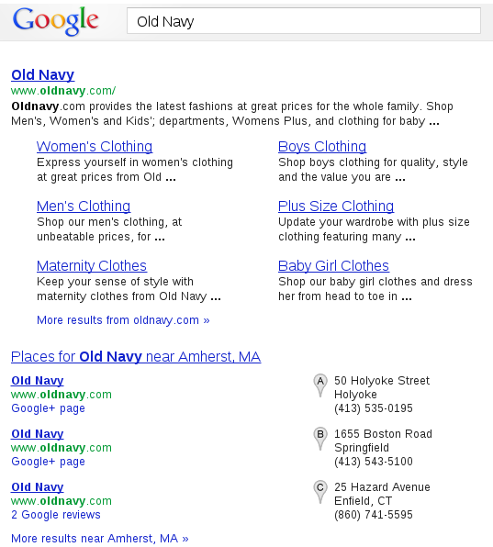
Personalization on the Web
Santa Barbara, California
Amherst, Massachusetts

Slide 13









Personalization is Ubiquitous
Search Results
Social Media
Goods and Services
Music, Movies, Media

Slide 14
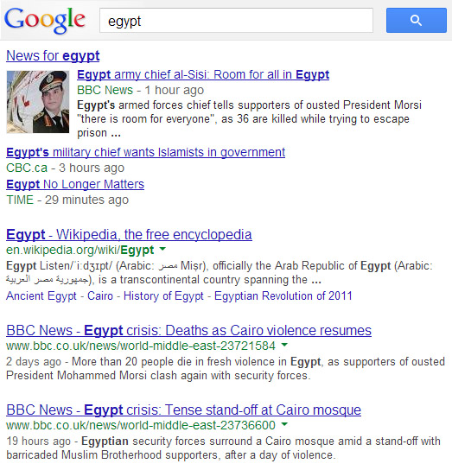

Dangers of Personalization
Current Events, News, Information
Travel and Tourism?
Relevant information might not be reachable
People are unaware of the personalization

Slide 15




Personalization as Filter
Online personalization is creating situations where we only see things that already suit our own tastes.
In the best case, you might miss a result
Boundary between censorship and personalization is blurry
Personalization can also be exploited!

Slide 16
Context
Search engines deliver inconsistent search results
These inconsistent results may sway searchers’ opinions or judgment to products or political events etc.
Notes:
Over the past few years, the personalized search technique is largely deployed on different search engines.
It incorporates a user’s individual information, tailors user’s search experience, and presents inconsistent search results to different users. However, …

Slide 17
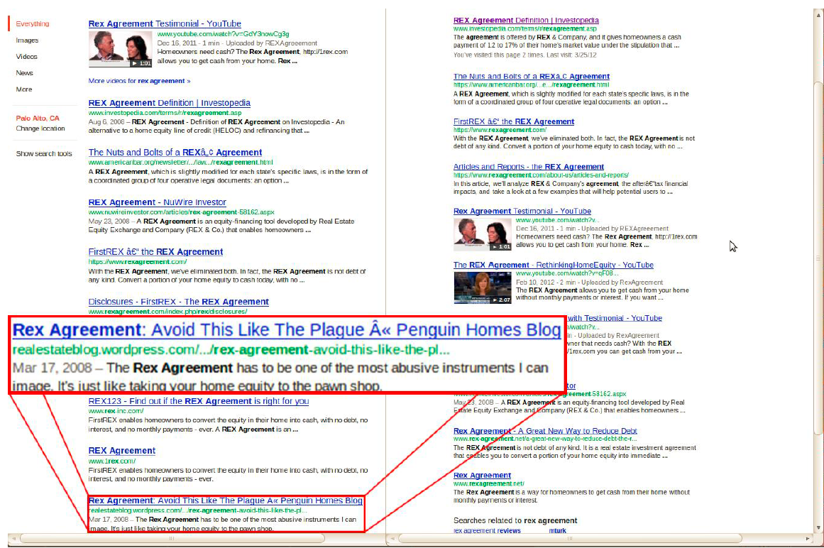
Rex agreement
From California
From Georgia
Notes:
I got two sets of results - one from … and the other from … I read the results carefully and found something really interesting
On the right hand side, the tone of the search results was positive and neutral.
However, the tone of search results from California was shifted and become slightly mixed. For example, one result said …

Slide 18
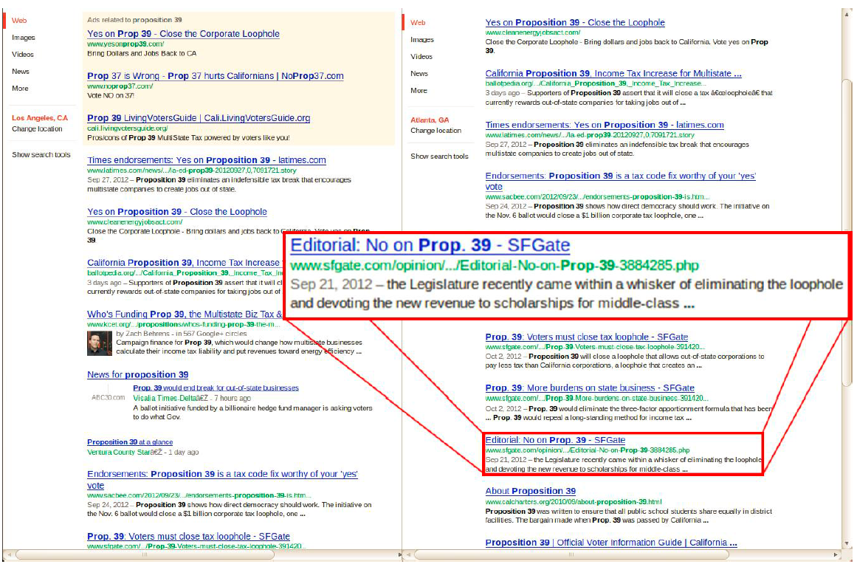
Proposition 39
From California
From Georgia
Notes:
Here is another example. I did the similar study from the same regions at the same time.
In particular, I searched a California ballot proposition before the voting actually took place in Oct. of 2012.
The tone of the search results from CA was overwhelmingly positive toward the proposition that CA should close an unfair corporate tax loophole.
But, the tone of the result set from GA was kind of mixed. It not only contained the results positive toward the proposition, but also the results negative toward it.

Slide 19
Search Personalization/Inconsistencies
Can we expose search inconsistencies?
What is the nature of inconsistencies?
Notes:
After seeing these impressive phenomenon, there are so many questions coming up in our mind. For example, we may ask
How serious this phenomenon is across a wide spectrum of search terms?
If proposition 39 has been passed? And
How Google react to these phenomenon? And so on …
Here, I can answer you a few … For example, I can tell you proposition 39 has been passed!
But, in this talk, I’m not gonna focus on these questions. Instead, I will devote all my energies on two prerequisite questions that are relevant, crucial and tempting.

Slide 20
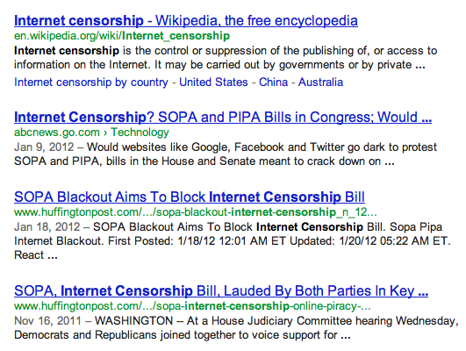
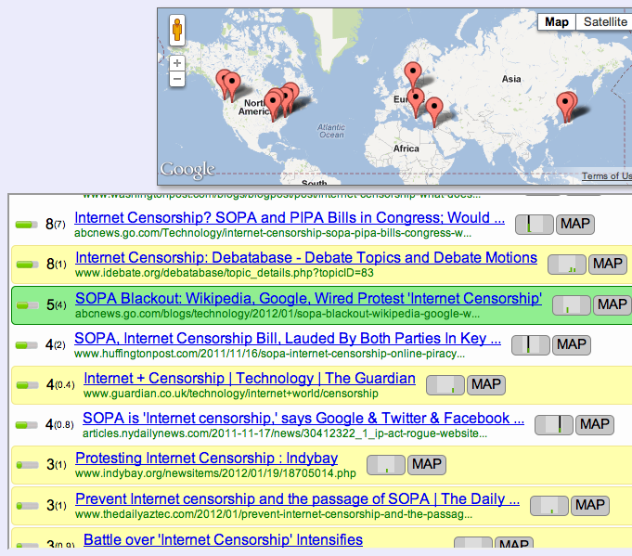

Bobble: Measuring the Filter Bubble
Things you didn’t see!
http://bobble.gtisc.gatech.edu/

Slide 21
Detecting Inconsistent Results
Execute user query
From a variety of different vantage points
As different users
With different history (e.g., cookies)
Compare differences in results across different vantage points
What shows up on the first page?
Where does it show up?
When it doesn’t appear, what are the possible explanations?

Slide 22
Experiment
Browser plugin, Bobble (http://bobble.gtisc.gatech.edu/)
allows users to see how the search results that Google returns to thediffers from the results that would be returned to other users distributed around the world
Collect the user’s search query and results
Study how users’ Google search results vary based on their geographic locations and past search histories (user profile)
Notes:
So, in his talk, I will first introduce a tool – a browser plugin, Bobble.
Second, I will talk about how we use Bobble to collect ...
Finally, I will use our collected data and study …

Slide 23





System Archictecture
Search term
Search term
Search results
Search results
Bobble User
Search term
Search term
Search results
Search results
Bobble Server
Notes:
… bobble users who install our browser plugin; bobble server that collects data from user and search engine; search agents that run on hundreds of PlanetLab nodes
Our Bobble works in the following way.

Slide 24
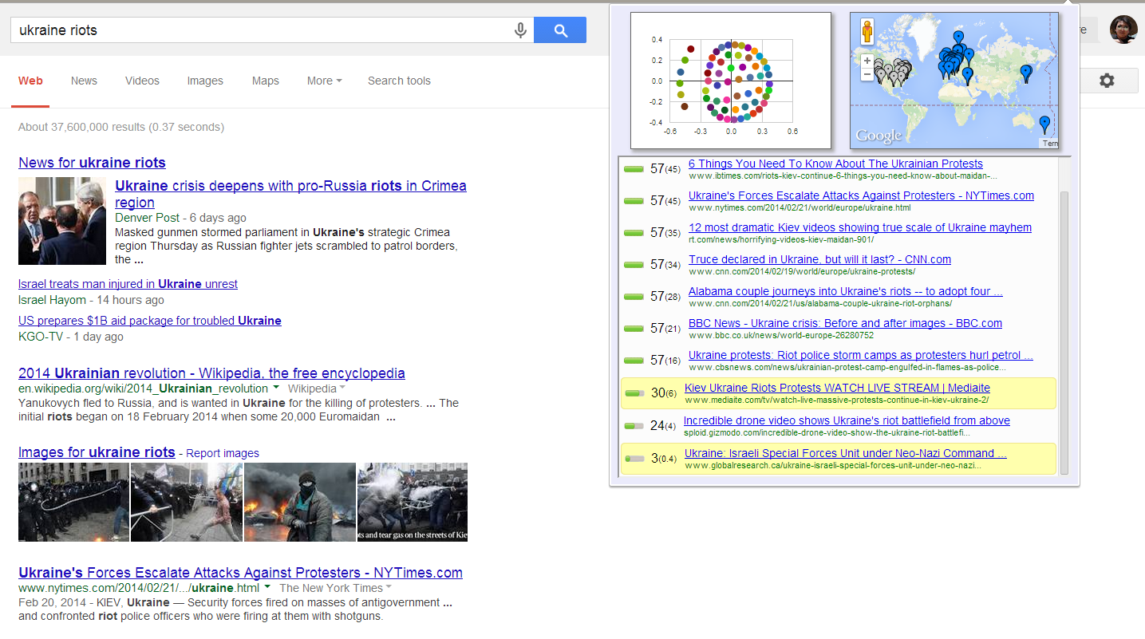
User Interface
Notes:
This is the user interface of bobble.
First, it ranks and shows all the search results from PlanetLab nodes.
Second, it highlights the results that don’t appear in a user’s results.
Third, it shows where the results come from
Last, it also uses a similarity measure to project the different search result sets into a 2-dimensional space.

Slide 25
Causes of Personalization?
Static Features
Gender
Age
Browser
Operating System
Location (IP Address)
Logged In/Out
Historical Features
Logged In/Out
History of Searches
History of Search Result Clicks
Browsing History

Slide 26
Requirements for Data Collection
Effects of user profile
search results of Google users
customized based on user profiles
not influenced by profiling (organic result)
Effects of geography
Organic search results from different regions
Notes:
As I mentioned beforehand, one of our goals is to understand the nature of search inconsistencies. So, we need to use bobble to collect data.
First, we collect two sets of data to study the effects of user profile. From the same location, we collect a user’s search results tailored by his user profile. Also, we collect the user’s organic search results independent on his profile.
Second, we get rid of the impacts of user profile, and use Bobble to collect organic search results from different regions.

Slide 27
Statistics
From 2012/1/17 – 2012/10/25 (9 months)
174 distinct Google-user installation
76,307 queries
66,138 queries issued by signed-in users (86.67%)
10,169 queries issued by signed-out users (13.33%)
Notes:
Here are some statistics about our deployment and our dataset.

Slide 28
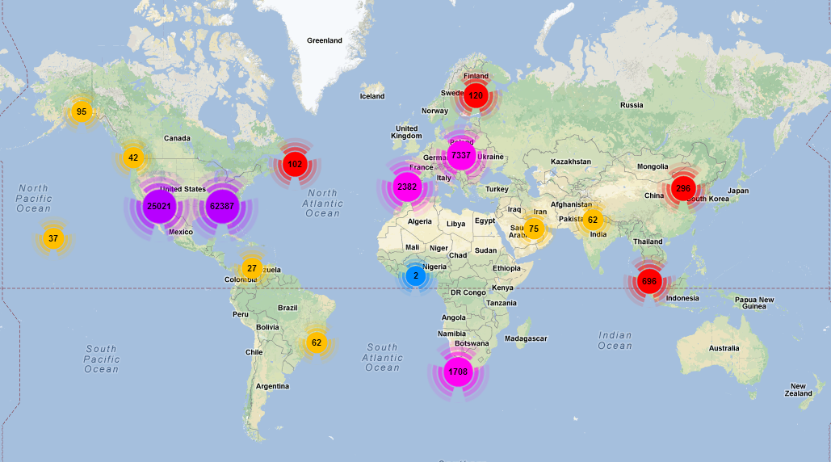
Geographic Distribution of Queries

Slide 29
Effects of Geography
Compare a user’s organic result set with organic search result sets (from different regions) concerning:
# of search results
rank
title
url
Notes:
We study the effects of geography on search inconsistencies. In particular, we …

Slide 30
Effects of Geography
Not in user’s result set, but in Google top 3 elsewhere: 30.66%
Not in user’s result set, but in Google top 10 elsewhere: 86.41%
At least one result appears in Google user’s result set but does not appear at other PlanetLab nodes: 1.88%

Slide 31
Effects of User Profile
Google profiles users according to
signed-in sessions
signed-out sessions with cookies enabled
Collect search results when
Google users sign in
Google users sign out (with cookies enabled)
Notes:
Getting the results tailored by user profile is less challenging. Google profile users when they login their Google accounts or enable their Google cookies, so our browser plugin sends users’ results to our Bobble server when it sees the users logged in or enabled their coockies.

Slide 32
Logged In/Out to Google (Controlled)
Same results
…But in a different order

Slide 33
Comparison
 | Signed-in dataset | Signed-out dataset
Profile influence on inconsistency | 64.19% | 58.77%
User profile has less effects on inconsistencies than geographic location (~97% vs. ~60%)
Signed-in profile has slightly more effect on inconsistency than signed-out profile.
Notes:
Here is the first comparison …

Slide 34
Effects of User Profile
Not in user’s organic result set, but in Google top 3 elsewhere: 30.66%
Not in user’s result set, but in Google top 10 elsewhere: 86.41%
At least one result appears in Google user’s result set but does not appear at other PlanetLab nodes: 1.88%

Slide 35
Conclusion
Search inconsistency is pervasive
Geographic location introduces inconsistency in about 98% of queries
User profile results in addition or removal of results more than 60% of the time
Next steps
More detailed study of how other factors affect results
More detailed analysis on how inconsistent results may sway public opinions

Slide 36
Internet Censorship and Online Speech Chapter 7.3: Filter Bubbles in the News
Nick Feamster University of Chicago

Slide 37
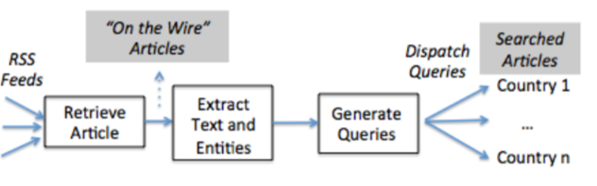
Study Process

Slide 38
Questions
Diversity of news sources in various countries?
Differences in news sources across countries
Differences in search results across countries?

Slide 39
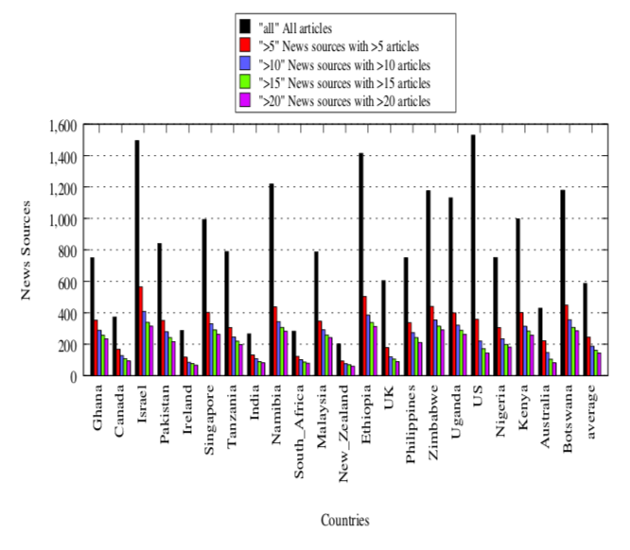
Diversity of News Sources Across Countries

Slide 40
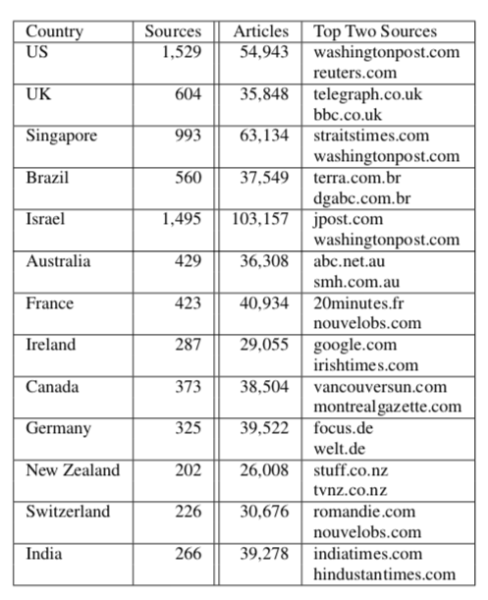
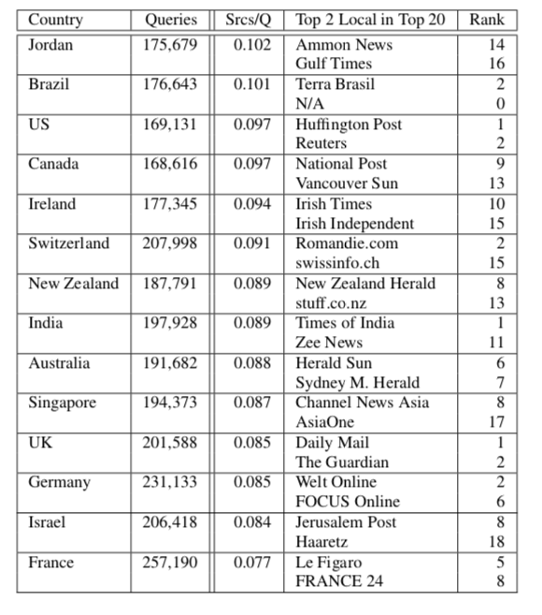
Localization of News Sources

Slide 41
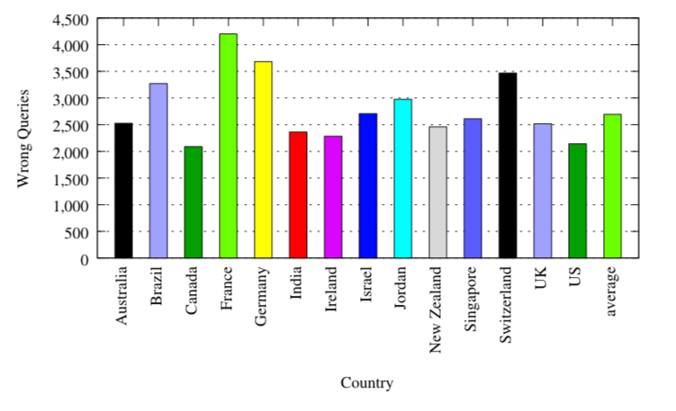
Queries that Returned Empty Results

Slide 42
Pollution Attacks

Slide 43
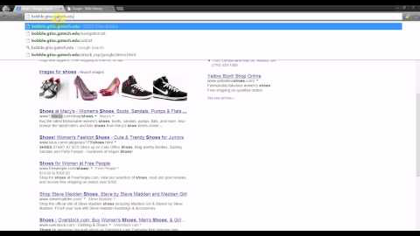
Pollution Attacks
Take This Personally: Pollution Attacks on Personalized Services. X. Xing, W. Ming, D. Doozan, A. Snoeren, N. Feamster, W. Lee. In USENIX Security Symposium, 2013.

